Slide 1
In certain cases where evidence is beyond the knowledge and skill of court, evidence create problem for court to come to any conclusion. In such situation court takes the help of expert evidence. Expert is a person who has high knowledge and skill in particular field. Evidence is information given by a person that proves the allegation to be true or false. So expert evidence is information or statement made by a person who is specialized in that particular field of work or which he has given that information. Expert evidence is required to assist the court when the case before it involves matters on which court does not have the requisite technical or specialist knowledge.
Expert evidence is corroborative and advisory in nature. It is not binding in all the cases. Opinion on evidence given by witness is not compulsorily binding to court. It wholly depends on the situational circumstances whether the expert evidence and opinion given by expert witness is relevant or not and what is its evidentiary value. Expert witnesses are appointed by court in only those cases where court lacks in knowledge about the case and if court feels it necessary for the interest of justice. There are requisite rules to be followed by experts in giving their expert report to the court and the court may call upon the expert for testimony. Court does not rely on this corroborative evidence but on primary evidences-documents itself produced for the inspection of the court. Expert evidence is given in both civil cases as well as in criminal cases. T

Slide 2
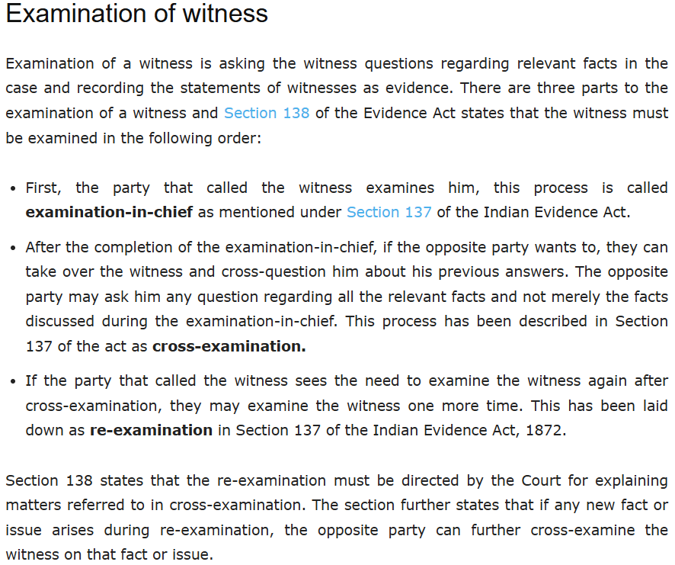

Slide 3
https://blog.ipleaders.in/examination-and-cross-examination-of-witnesses-under-the-indian-evidence-act/

